Slide 1
Parallel Data Structures
Queue and Linked List
Daniel Rivera Ruiz (N10385937)
Fatima Mushtaq (N15760010)
Professor Mohamed Zahran
CSCI-GA.3033-016 Multico Processors
NYU - Courant Institute of Mathematics

Slide 2
Problem Definition
Like other programming languages, the goal is to support concurrent thread-safe data-structures in OpenMP.
Provide Parallel Implementation for two data structures: Queue and Linked List.
Requirements:
Correctness (linearizability): the responses received in every concurrent history are equivalent to those of a legal sequential history and their order is consistent with the real-time order.
Scalability: at least some of the operations defined for each data structure have better performance as the number of threads increases.

Slide 3
Experiments
For both data structure, developed two implementations: lock-based and lock-free.
Lock-based implementation uses OpenMP lock functions: test, set, unset, etc.
Lock-free implementation uses C++ libraries: <atomic>, pthreads or OpenMP.
Concurrent Queue Implementation supports 6 APIs:
EnQueue(T), T DeQueue(), T head(), T tail(), isEmpty(), isFull()
Lock free Implementation is done in a way that it uses one Atomic Stmnt only i.e. atomic capture.
Concurrent Linked List Implementation supports 15 APIs, mainly:
add(index, T), remove(index), get(index), set(index, T), indexOf(T), contains(T)
We performed several experiments for each implementation, variating the number of threads and the type and number of operations performed. The main metric we used to evaluate performance is execution time as measured with omp_get_wtime().

Slide 4
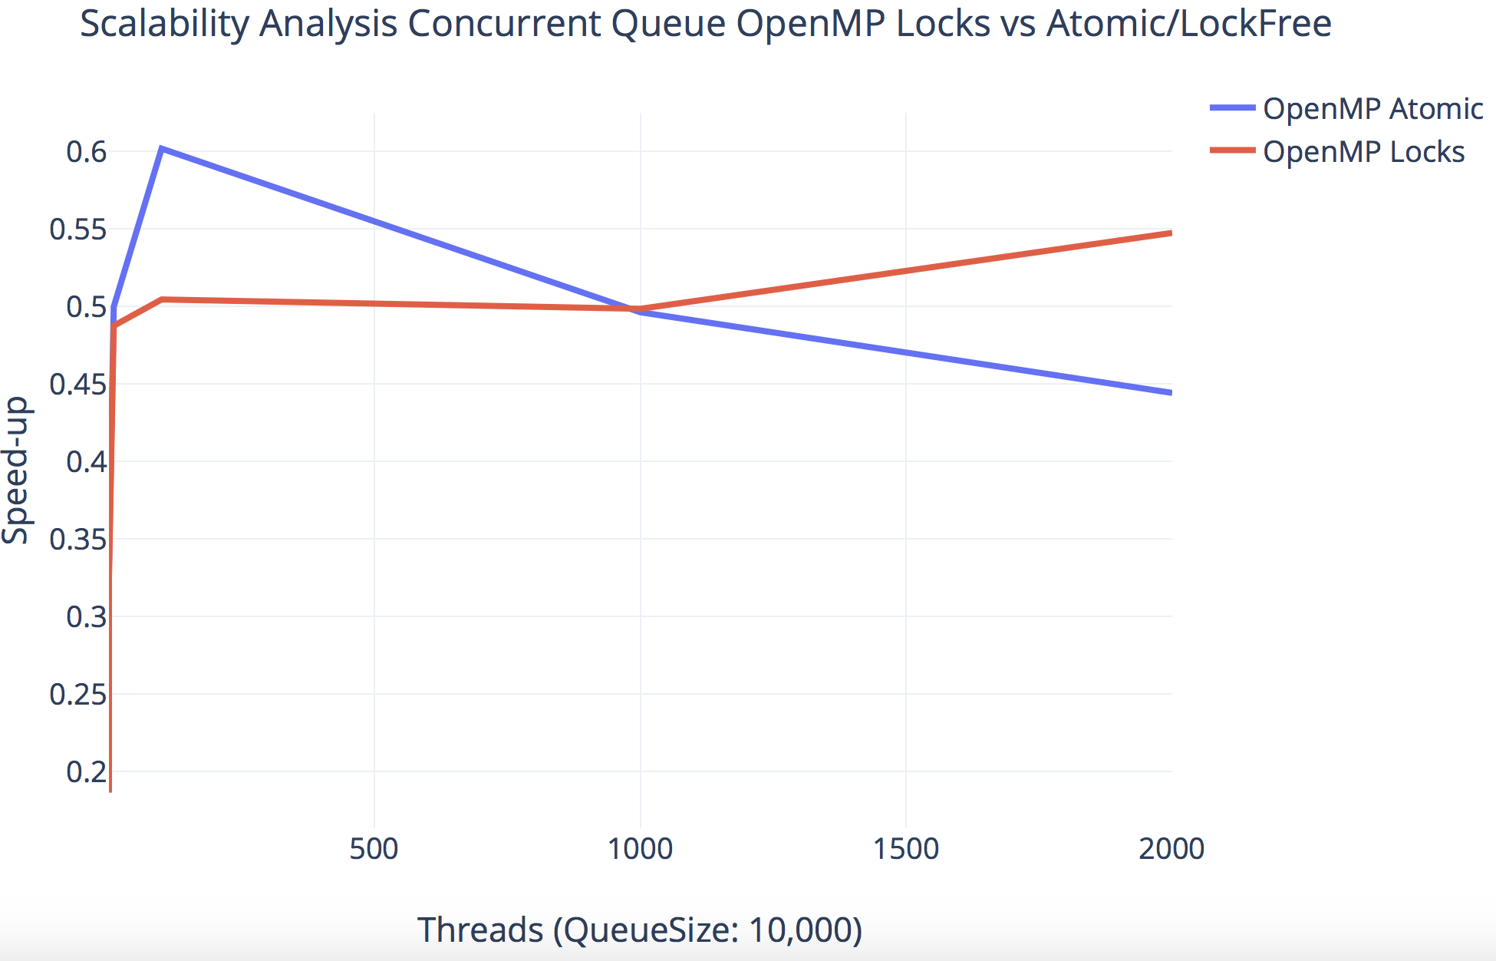
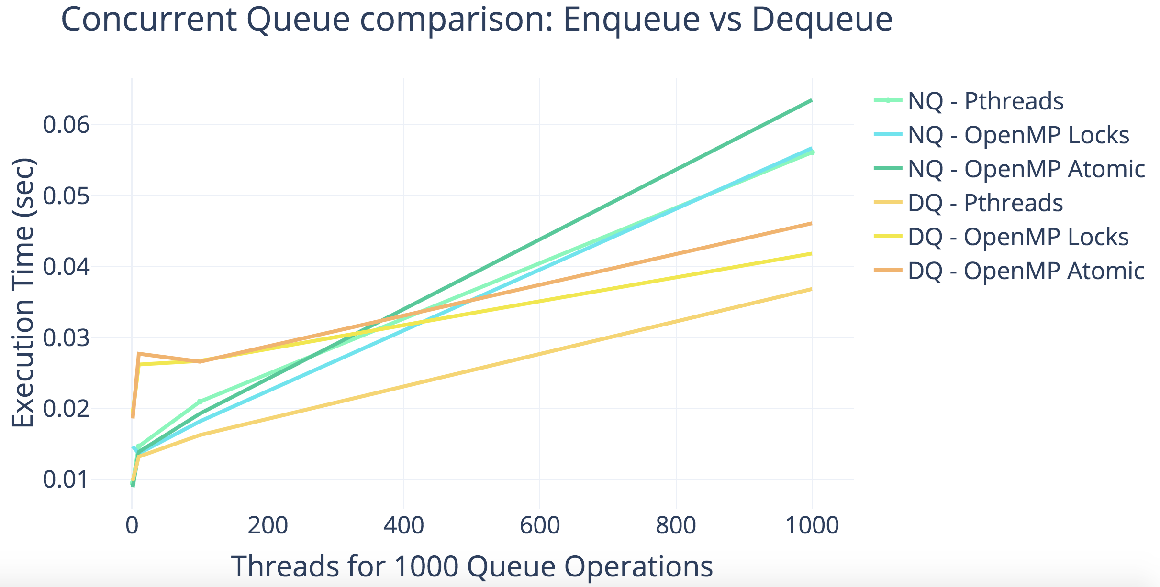
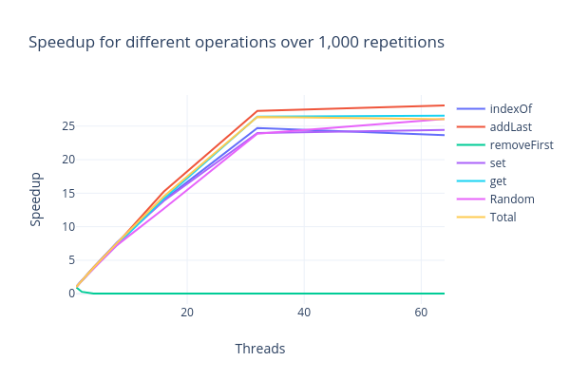
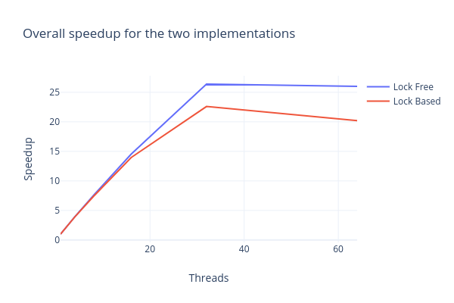
Results
Concurrent Queue Performance
Concurrent LinkedList Performance

Slide 5
Conclusions
Queue:
Pthreads/Mutex has shown to be more efficient than OpenMP Implementation.
Lock-Free approach is complex. It showed less performance gain in OpenMP.
Concurrent queue implementation in OpenMP scales with problem size and number of threads.
Linked List:
Operations that try to modify the list at the same location every time (e.g. addFirst(), deleteFirst(), etc.) do not benefit from parallelism.
The most challenging operation in the parallel implementation of a Linked List is deletion, since it requires two atomic operations to ensure correctness.

